Slide 1
The Schedule Tribes and other Traditional Forest Dwellers ( Recognition of Forest Rights) ACT 2006
FOREST RIGHTS ACT
2006

Slide 2
PREAMBLE OF THE ACT
An Act to recognize and vest the forest rights and occupation in forest land in forest dwelling Schedule Tribes and other traditional forest dwellers who have been residing in the forests for generations but whose rights could not be recorded.

Slide 3
TYPES OF RIGHTS
COMMUNITY
A FAMILY
COMMUNITY OF THE VILLAGE
INDIVIDUAL
A FAMILY

Slide 4
COMMUNITY FOREST RESOURCE
Community Forest Land of a community within the Traditional or Customary boundaries of the village including reserved forests, protected forests and protected areas such as Sanctuaries and National Parks to which the Community had traditional access

Slide 5
Which are the Rights?
Right to hold and live in the forest land for habitation or for self cultivation for livelihood
Nistar Rights
Right of ownership of Minor Forest Produce (MFP) and right to collect, use and dispose off MFP
Section 3(1) of the Act secures Forest Rights of Community and Individuals

Slide 6
Which are the Rights?
Community rights or entitlements to use water bodies products such as fish etc
To use Grazing Lands
Right for habitation to the Primitive Tribal groups
Right over Disputed forest land.
Section 3(1) of the Act secures Forest Rights of Community and Individuals

Slide 7
Which are the Rights?
Right for Conversion of Pattas or leases or grants issued by any local authority or by Govt Authorities
Rights for settlement and conversion of Unsettled or un - surveyed forest villages into revenue villages
Section 3(1) of the Act secures Forest Rights of Community and Individuals

Slide 8
Which are the Rights?
Right to protect, regenerate, conserve and manage the Community Forest Resource
Right to access bio-diversity and Community right to intellectual property and traditional knowledge
Right to rehabilitation of ST’s and OTFD’s from where they were illegally displaced from the forest land prior to 13.12.2005
Section 3(1) of the Act secures Forest Rights of Community and Individuals

Slide 9
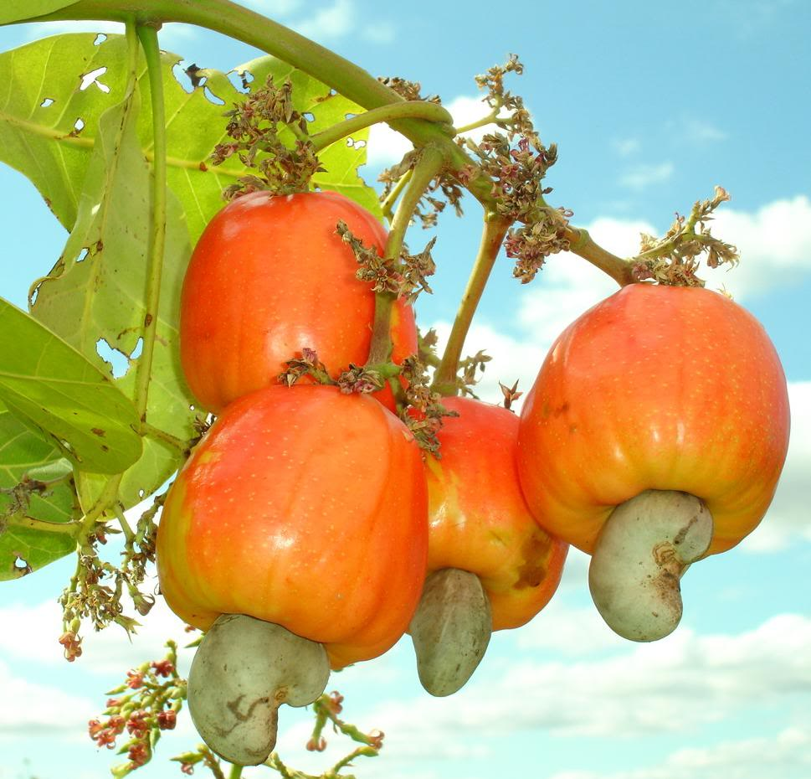
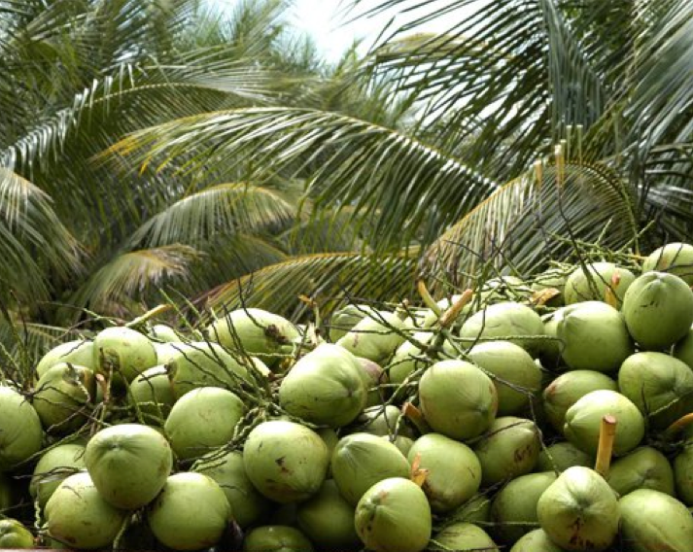
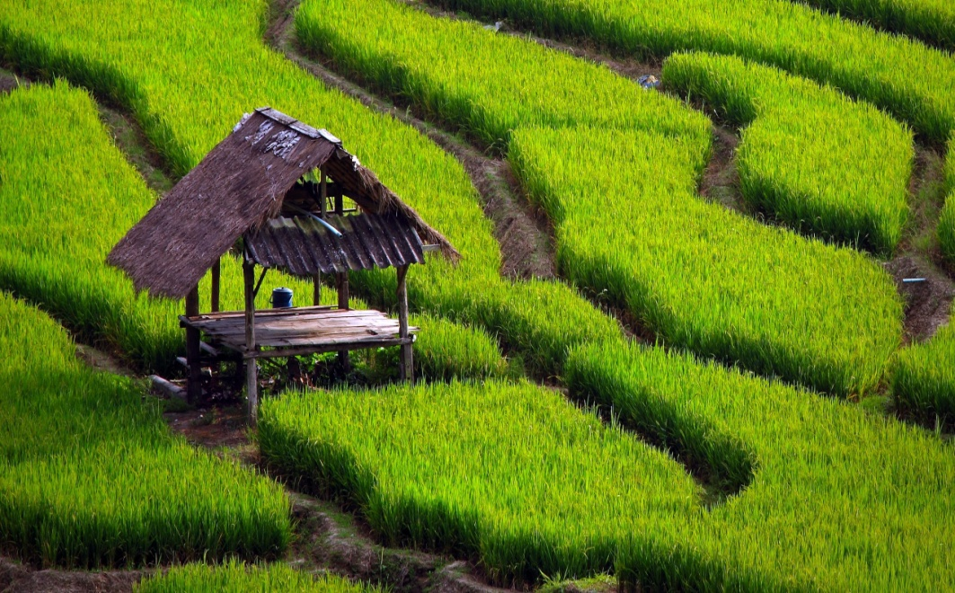
How we consider our forest rights…

Slide 10
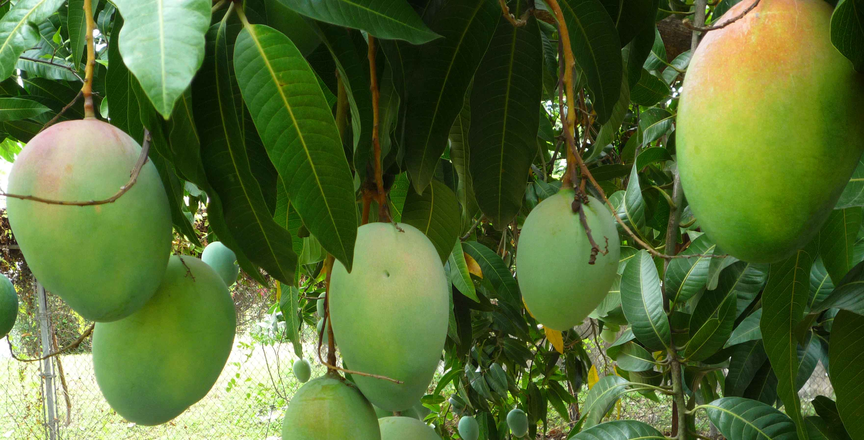
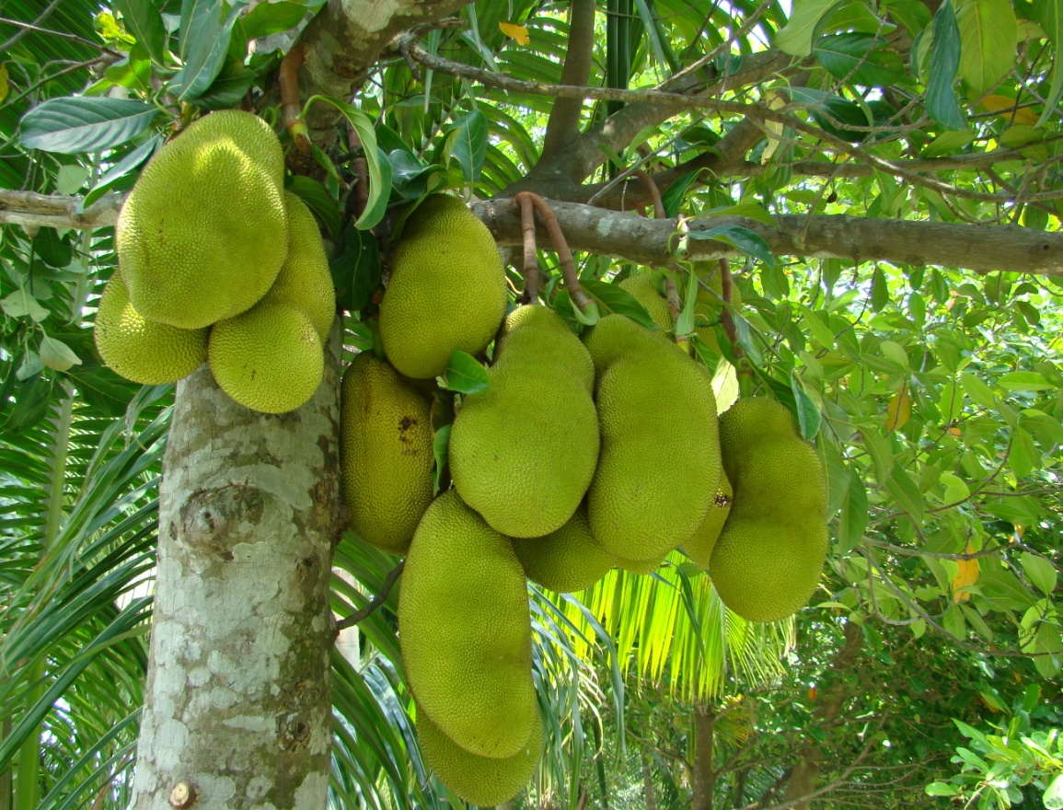

Slide 11
AND WHAT WE FAILS TO CONSIDER IS

Slide 12
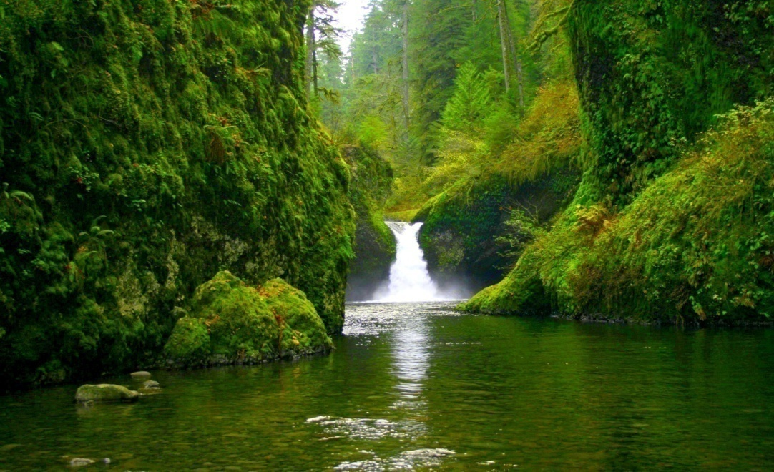
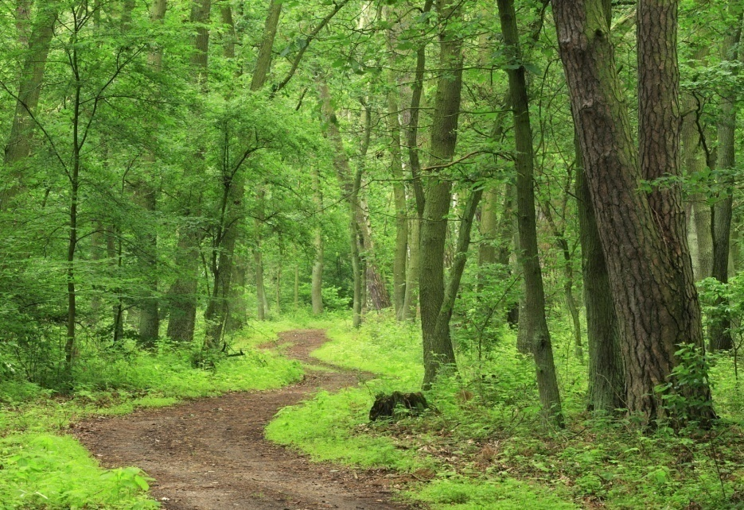
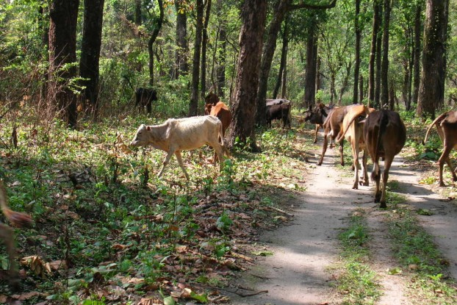
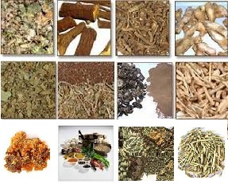

Slide 13
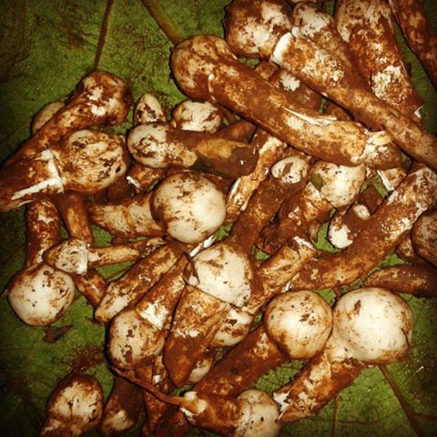
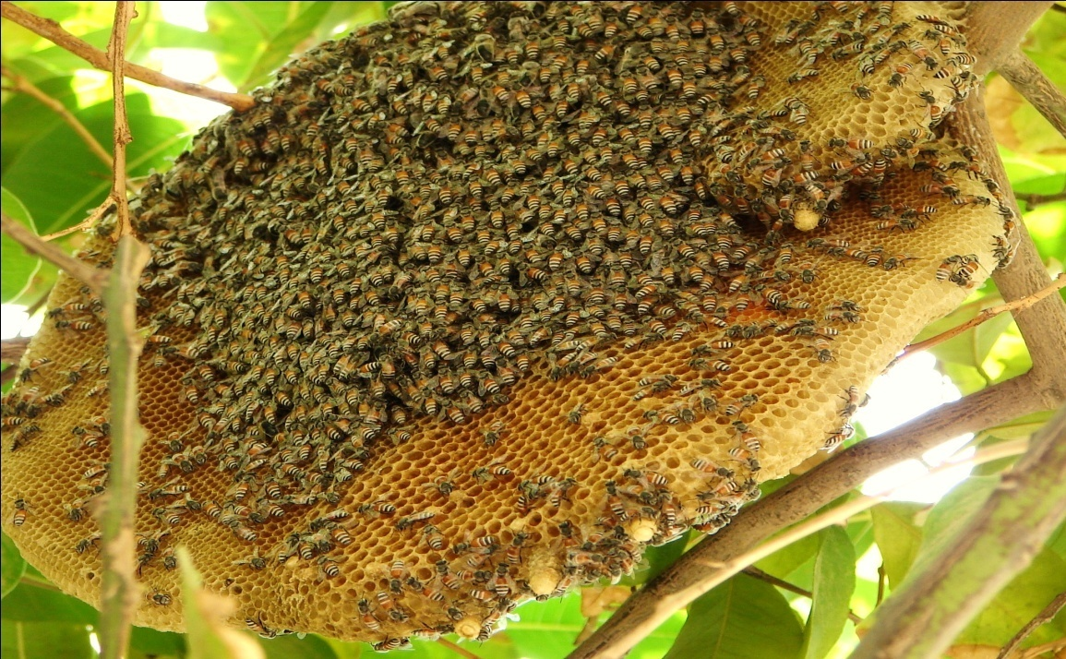
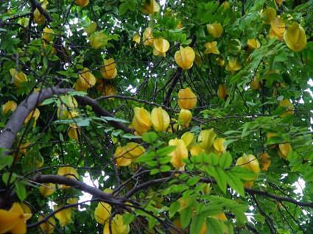

Slide 14
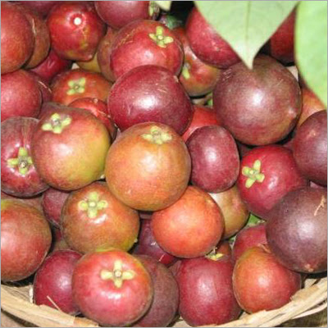
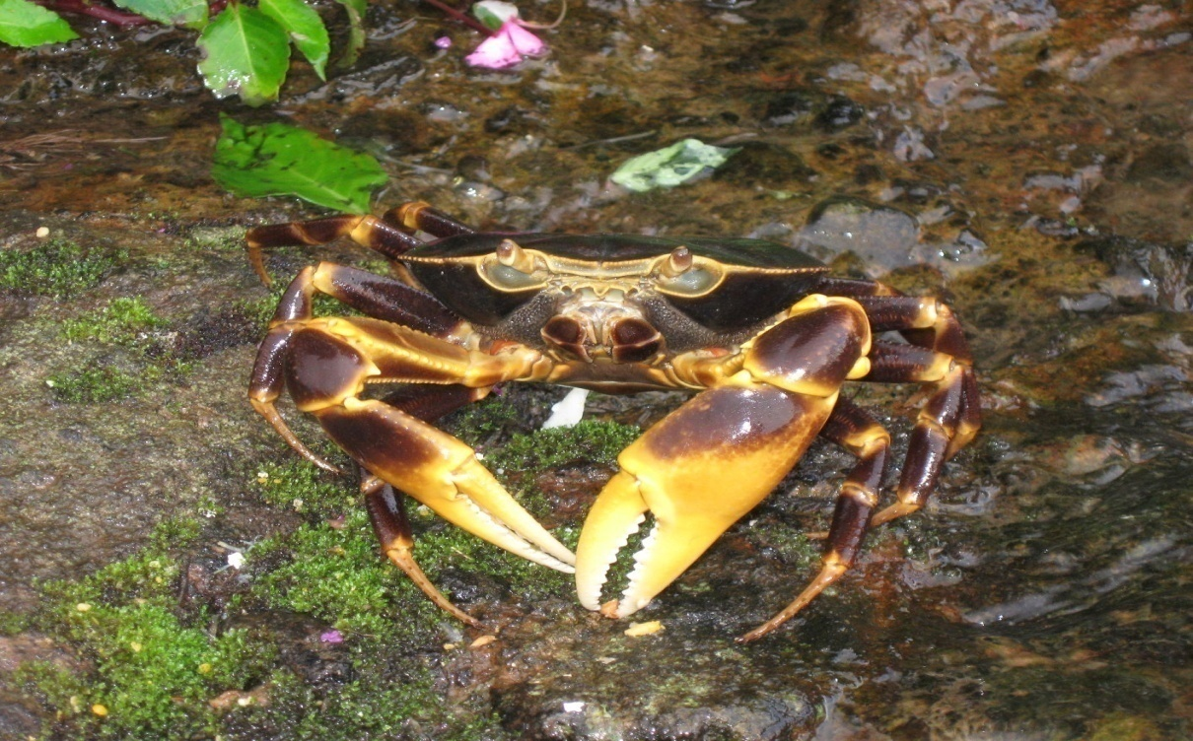
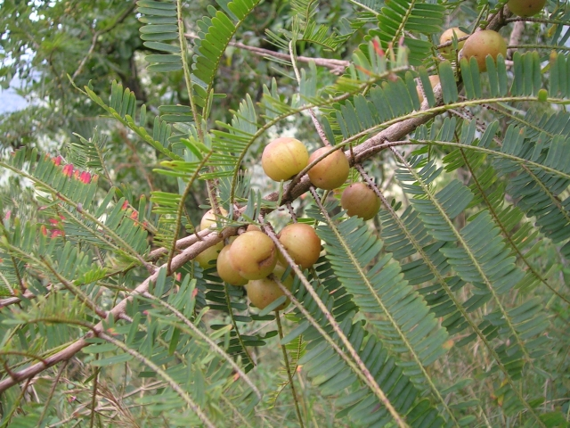
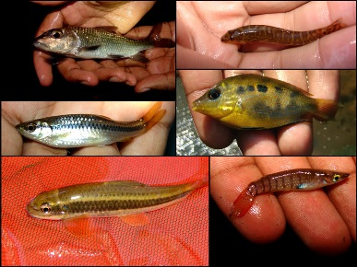

Slide 15
Individual forest rights
Forest rights referred in section 3 (1) of the act, on a Forest land less than 4 ha, which is in physical possession of an Individual prior to 13th December 2005

Slide 16
Community Forest Rights
All the Forest Rights referred in Section 3(1) of the act of a Forest Dwelling Community

Slide 17
Community Forest Resource
It is the common forest land of a community with the traditional boundaries of the village including reserved forests, protected forests and protected areas such as Sanctuaries and National Parks to which the community had traditional access.

Slide 18
Section 3 (2) of the act
Section 3(2) of the act provides the diversion of forest land for the purpose of
a) Schools
b) Dispensary or hospital
c) Anganwadis
d) Fair price shops
e) electric and telecommunication lines
f) Tanks and other minor water bodies
g) drinking water supply and water pipelines

Slide 19
Section 3 (2) of the act
h) water or rain water harvesting structure
i) Minor irrigation canal
j) Non-conventional source of energy
i) Skill up gradation or Vocational training centres
k) roads and
l) Community Centres

Slide 20
Section 3 (2) of the act
All the above facilities shall be managed by the Govt
Area shall be less than 1 ha
Shall be proposed by Gram Sabha
Felling of Trees shall not exceed 75 trees per ha

Slide 21
Difference between IFR and CFR
Individual Forest Rights
Community Forest Right
Right of One family over Forest land
Limited by the Forest Land under actual occupation by an Individual (Max 4 ha)
Only cultivated lands are secured
Right of the whole community over Forest land
Limited by the land accessed by the community
Community resources such as Springs, rivers , intellectual knowledge and all the Minor Forest produce are secured

Slide 22
Difference between IFR and CFR
Individual Forest Rights
Community Forest Right
Compulsorily 2 evidences out of the 13 evidences which are mentioned in Rule 13 are required
Right to protect, conserve, regenerate and manage only cultivated land by an individual
Traditional evidences of the community
Right to Protect, conserve, regenerate and manage the entire Forest land within the traditional boundary of the village

Slide 23
Procedure for Claiming CFR of a Village
Step 1 - Gramsabha
a) Issue of Notice convening Gramsabha by V.P Secretary
b) Ensure 50% Quorum
c) Pass a resolution for claiming Community Forest Rights and Community Forest Resource land
d) Ensure that the V.P Secretary Submits the minutes of the Gramsabha to the SDLC

Slide 24
Procedure for Claiming CFR of a Village
Step 2 – Seek Information
a) Forest Right Committee shall write a letter to the Chairman of SDLC requesting information such as forest and revenue maps, Forest land related notings from the Talathis office, voters list, Forest encroachment case notings etc.
b) The Chairman of the SDLC shall provide all the available information under Rule 12(4) and shall depute a competent officer to explain the same if required.

Slide 25
Procedure for Claiming CFR of a Village
Step 3 – Ancestral Boundary of Village
a) Physically demarcate the Ancestral Boundary of the village.
b) Identify all the places like Mountains, Rivers, Community habitat, plantations, sacred forests etc.
c) Prepare a map with all the above notings with the help of GPS.

Slide 26
Procedure for Claiming CFR of a Village
Step 3 – Evidences
a) Collect all the evidences which are available with the village Community if any.
b) Record Statement of the elder persons from the village

Slide 27
Procedure for Claiming CFR of a Village
Step 5 – Verification of Traditional Boundary
The physically demarcated boundary will be then verified by at least two of the elder person not less than 75 yrs from at lease two of the respective adjacent villages in the presence of the Chairman or Secretary and any one of the member.

Slide 28
Procedure for Claiming CFR of a Village
Step 4 – Certificate from Sarpanch
Request Sarpanch of Village Panchayat to issue a certificate stating that the Community belongs to the Schedule tribe and are dependent on the Forest land for their livelihood

Slide 29
Procedure for Claiming CFR of a Village
Step 4 – Preparation of Community Claim
All the Gramsabha members of the village are the Claimants for Community Claim.
Record all the Traditional rights which are applicable excluding hunting and Timber wood in the claim form .
The claim form shall be then signed by all the Gramsabha Members.
Note:1) Do not make fraud Signatures
2) Take 3 xerox copies of the Claim form

Slide 30
Procedure for Claiming CFR of a Village
Step 5 – Notice for Verification of Community Claim
The Secretary of FRC shall send a notice by fixing a date for verification along with the xerox copies of Community Claim to the Concern authorities before 7 days.

Slide 31
Procedure for Claiming CFR of a Village
Step 6 – Verification of Community Claim
Verification Report shall be prepared by the FRC along with all the Concern authorities as per Rule 12 (2)
At this stage, The Concern departments shall note down their suggestion /objections.

Slide 32
Procedure for Claiming CFR of a Village
Step 7 – Gramsabha Approval
The Secretary of V.P shall issue a notice for Gramsabha of the village.
50% of the Gramsabha members shall be the Quorum.
The FRC shall present the claim received before the GS as per Rule 11(2) (v) along with the verification report.
The GS shall pass a resolution for approval of the community claim after considering the findings of the FRC.

Slide 33
Procedure for Claiming CFR of a Village
Step 8 – Submission of Community claim to the SDLC
The Secretary of V.P shall execute the approved Community claim by the Gramsabha.
The Secretary of V.P shall submit the minutes of the GS, verification report, Claim form along with annexure (original), copies of notices to the SDLC.

Slide 34
Procedure for Claiming CFR of a Village
Step 9 – Reminder to the SDLC
The Forest Right Committee shall send a reminder letter to SDLC each after 7 days and 15 days about the Community claim.

Slide 35
Procedure for Claiming CFR of a Village
Step 10 – Information under RTI Act 2005
The FRC shall seek information under RTI Act 2005 if SDLC fails to process the Community claim filed.
Note: The SDLC shall process the Community claim within 30 days from the date of submission and shall submit the same to the DLC.

Slide 36
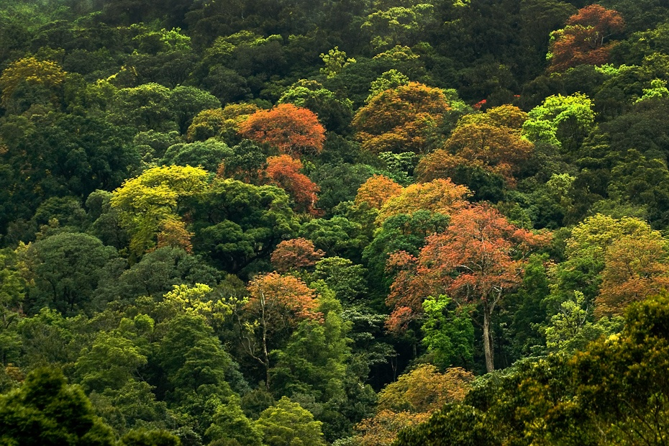
ITS YOUR FOREST
CLAIM YOUR RIGHTS TODAY

